Slide 1
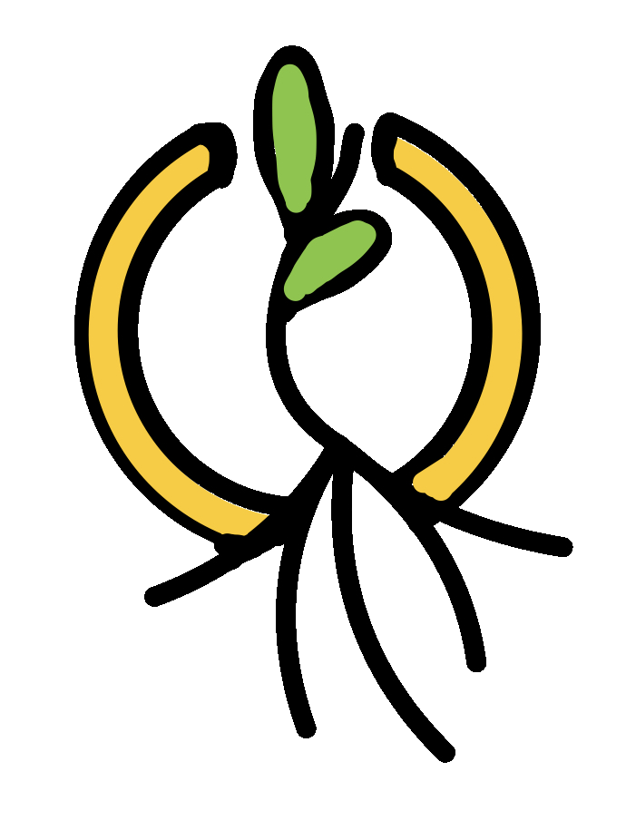
Grove
Low-fi Prototype and Testing

Slide 2
Overview
1
2
3
Exploring Design Ideas
The Low-fi Prototype
Usability Testing & Results / Analysis

Slide 3
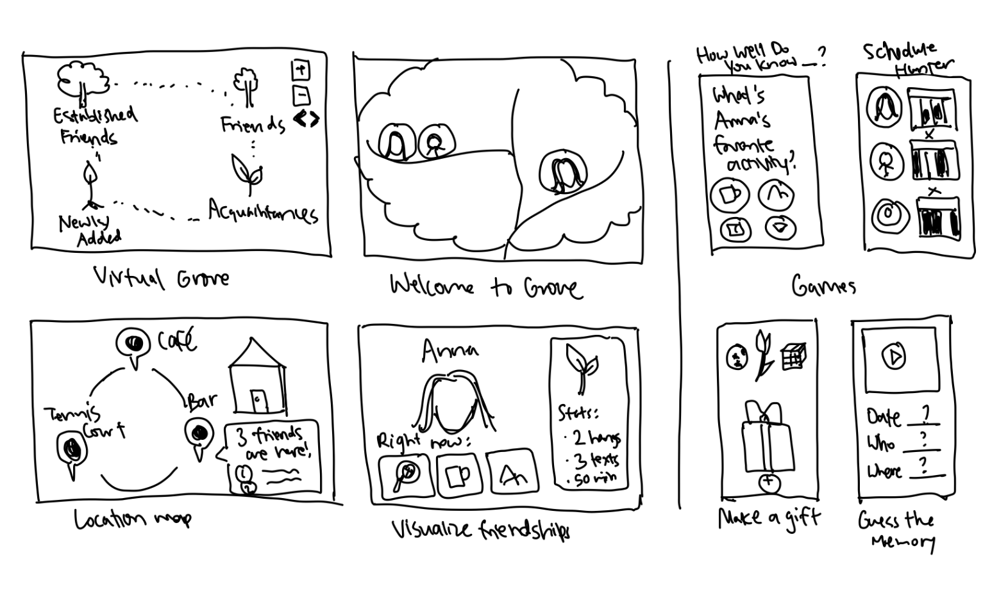
VR

Slide 4
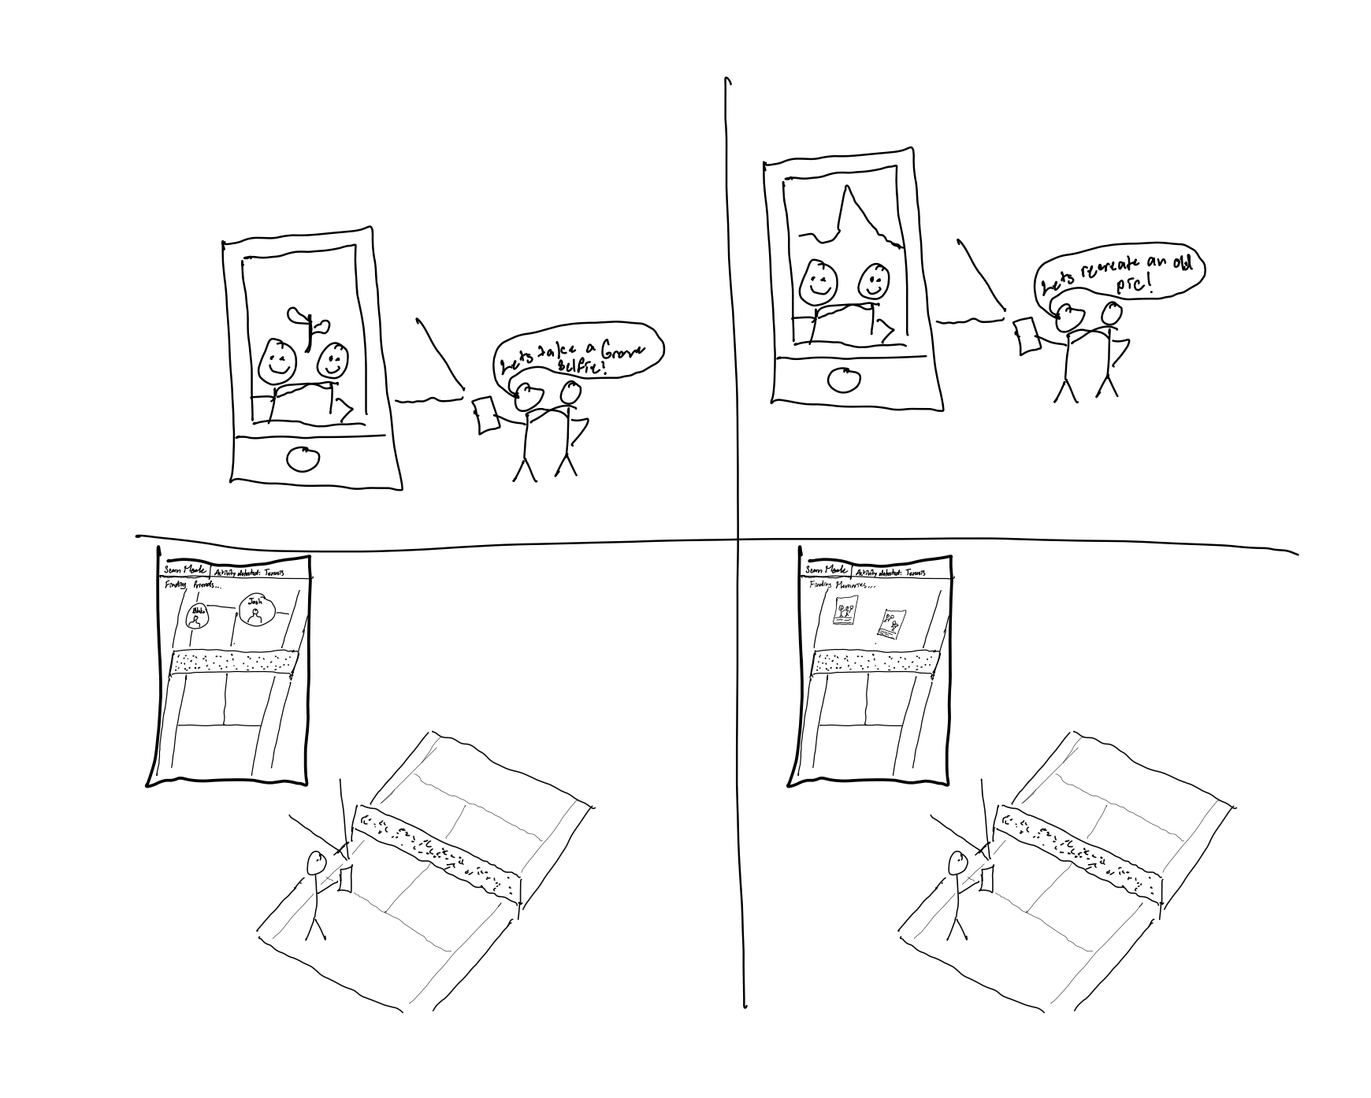
AR

Slide 5
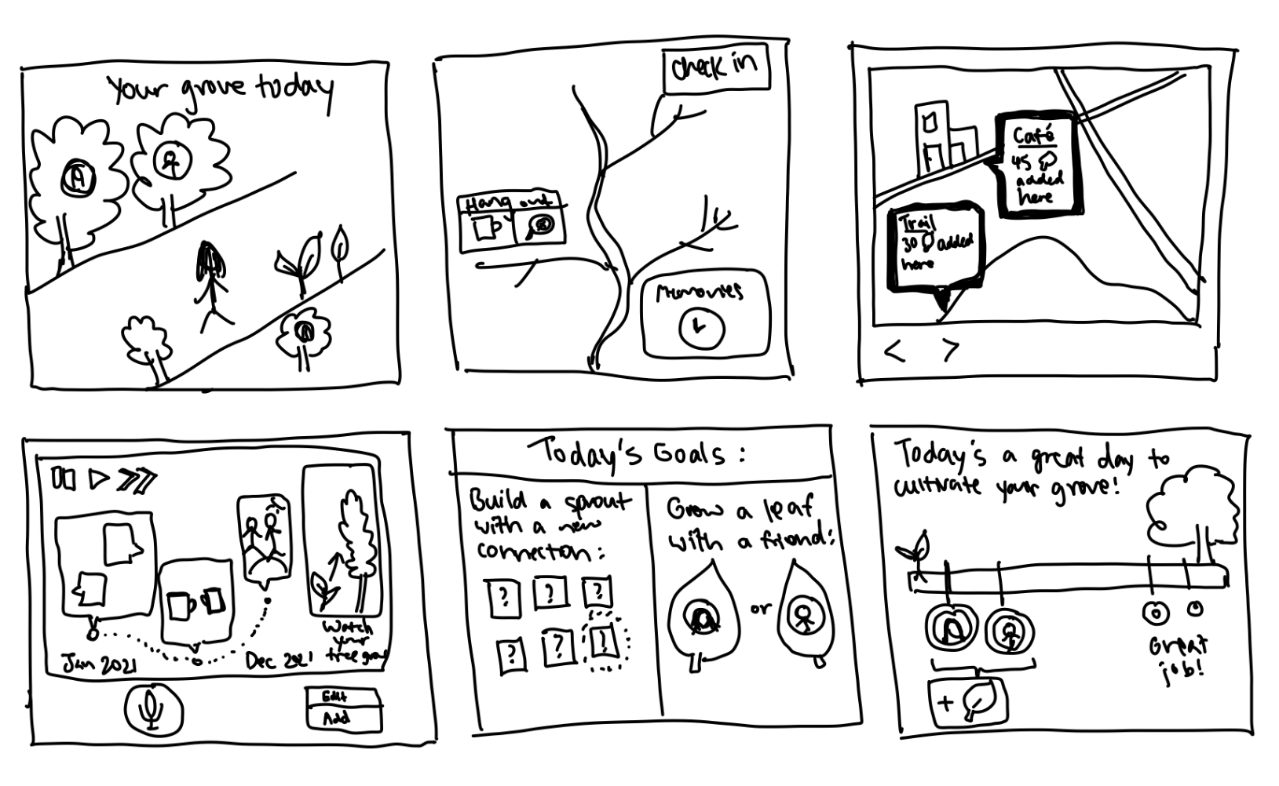
Native Tablet App

Slide 6
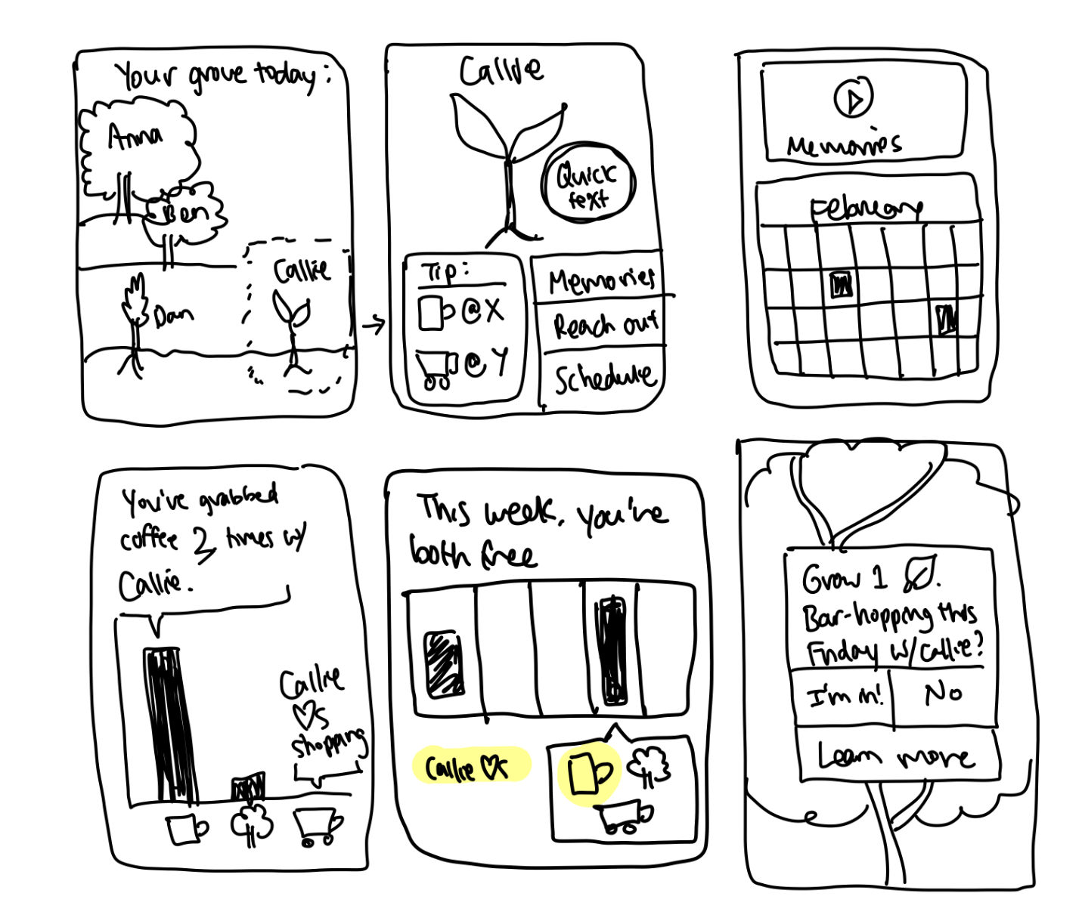
Native Mobile App

Slide 7
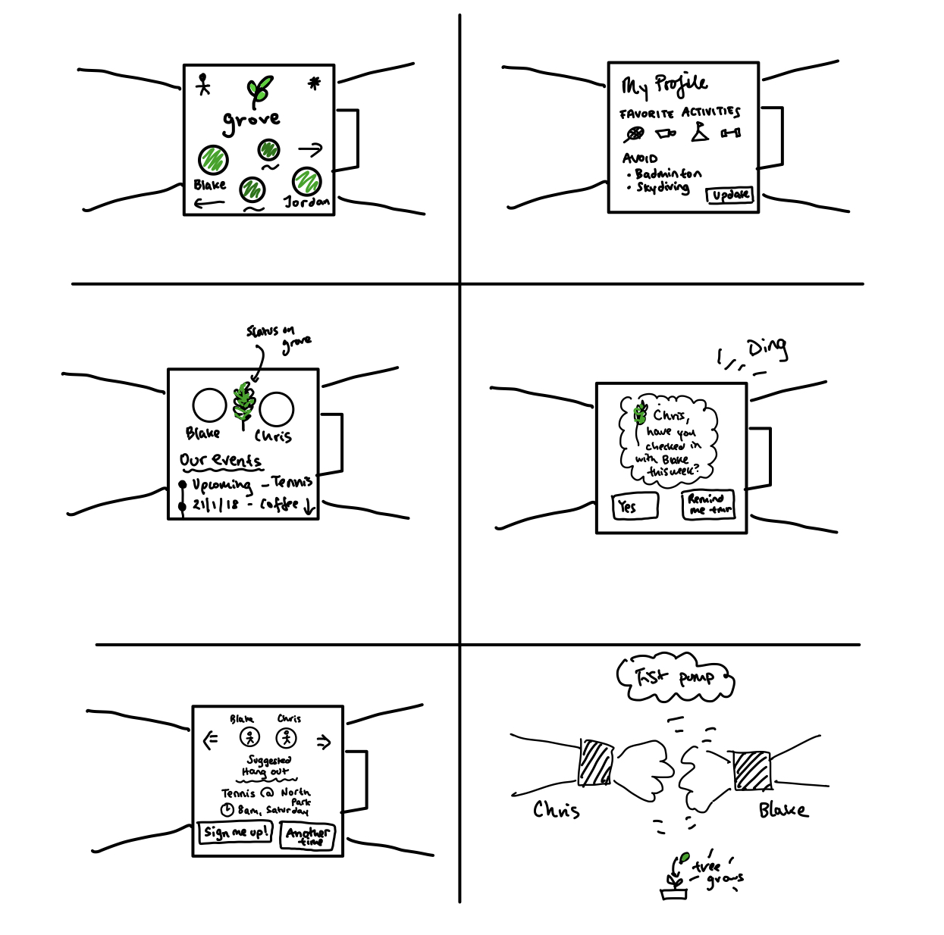
Wearable (Watch)

Slide 8
Interface Selection
Native Mobile App
AR
Wearable
Native Tablet App
VR

Slide 9
Interface Selection
Native Mobile App
AR
Wearable
Native Tablet App
VR

Slide 10
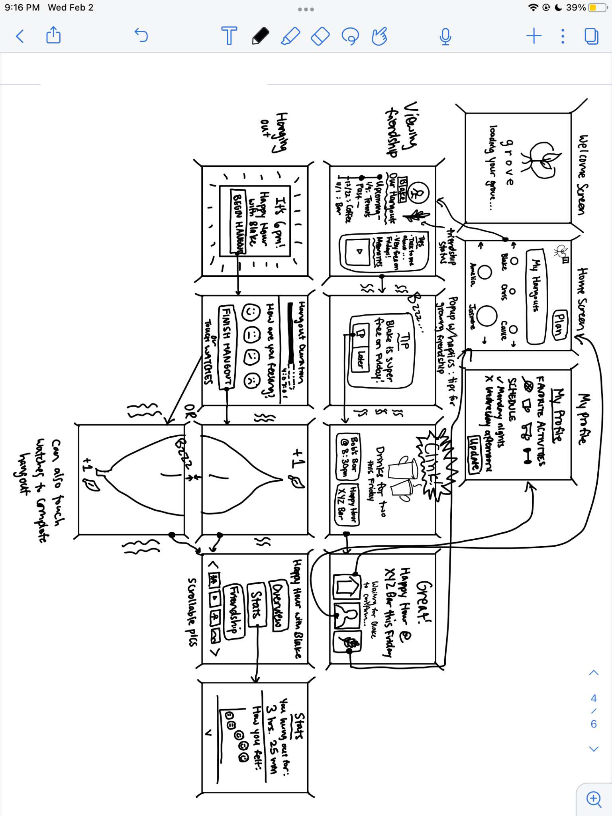

Storyboard 1 - Wearable

Slide 11
Wearable
Pros | Cons
Easier to document moments throughout a hangout Perpetual access to real-time information Straightforward user interface Hands-free and more portable | Short battery life and hassle to remove wearable to charge it Less space to display visual and textual information on screen Typically requires both wearable and mobile app together for complete functionality

Slide 12
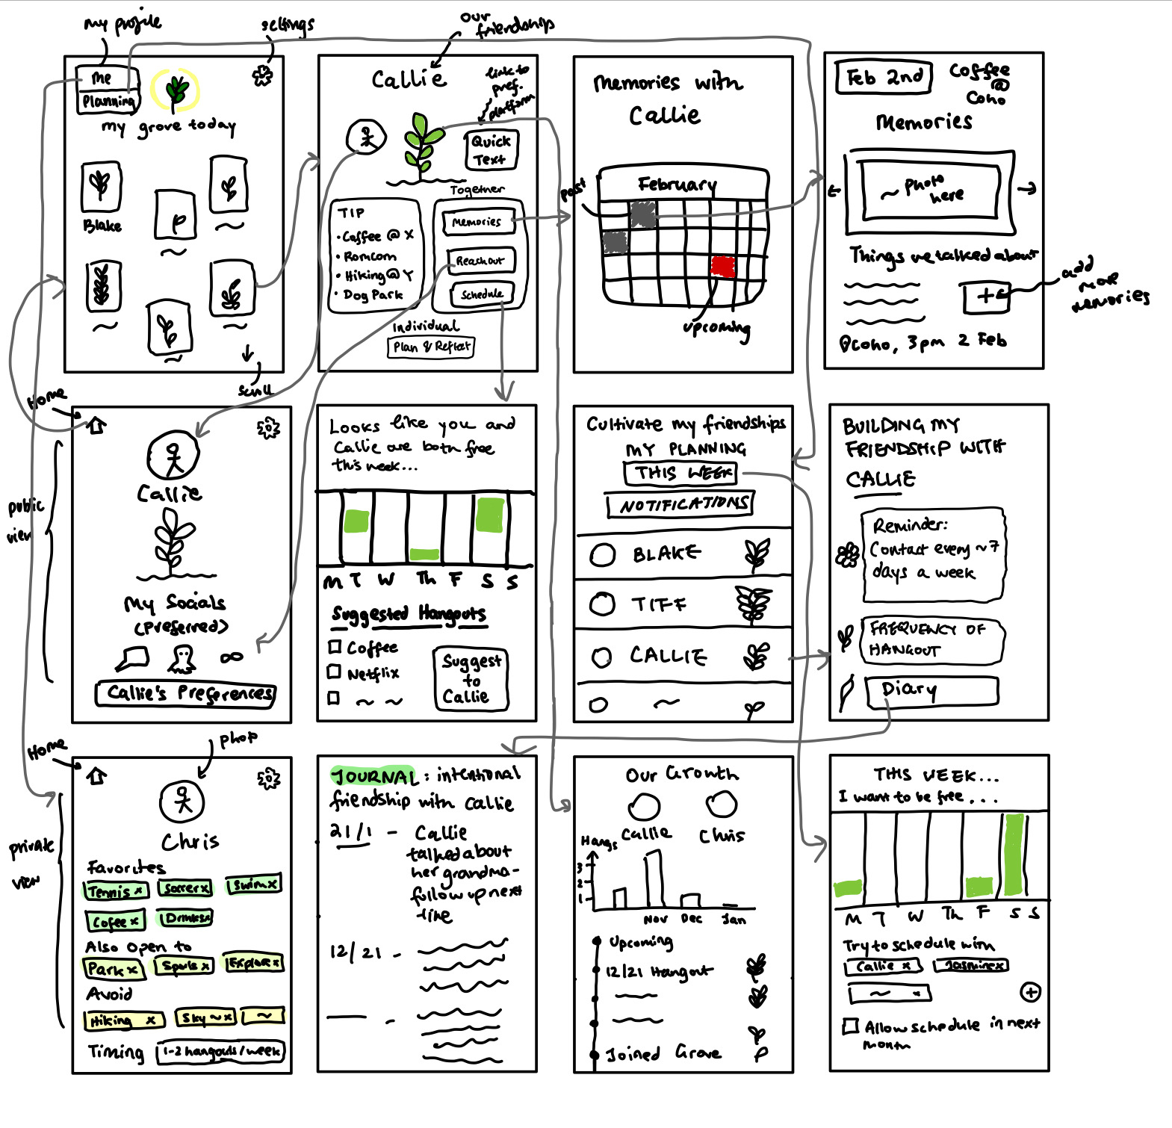
Storyboard 2 - Native Mobile App

Slide 13
Native Mobile App
Pros | Cons
Highly visual interface Can combine audio, visual, and haptic interactions for higher engagement Commonly used around the world, so easier integration into people’s daily lives Allows for a wide range of tasks | Hard to design for different operating systems More levels of functionality may make it less user-friendly and harder to update

Slide 14
Selected Interface
Native Mobile App
Wearable (Watch)

Slide 15
Selected Interface
Native Mobile App
Wearable (Watch)

Slide 16
2. The Low-Fi Prototype

Slide 17
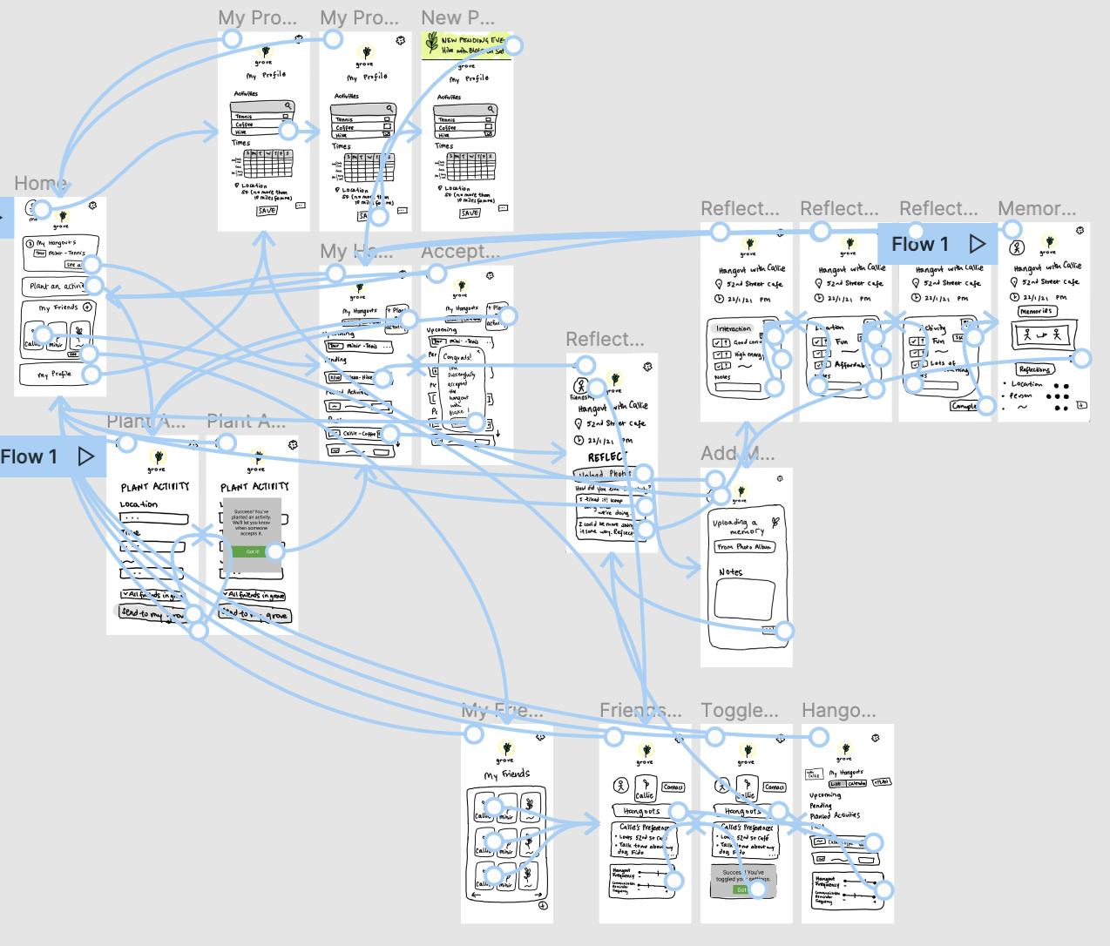
Low-Fi Prototype

Slide 18
Tasks
SIMPLE
MEDIUM
MEDIUM
COMPLEX
Set your activity and time preferences, and then accept a hangout that aligns with those preferences
Plant an activity–set an activity that you want to do
Follow up with an intentional cadence of future communication and hangouts
Reflect and report on the successfulness of a hangout across various aspects - activity, location, person

Slide 19
Simple
Task
Set your activity and time preferences, and then accept a hangout that aligns with those preferences

Slide 20
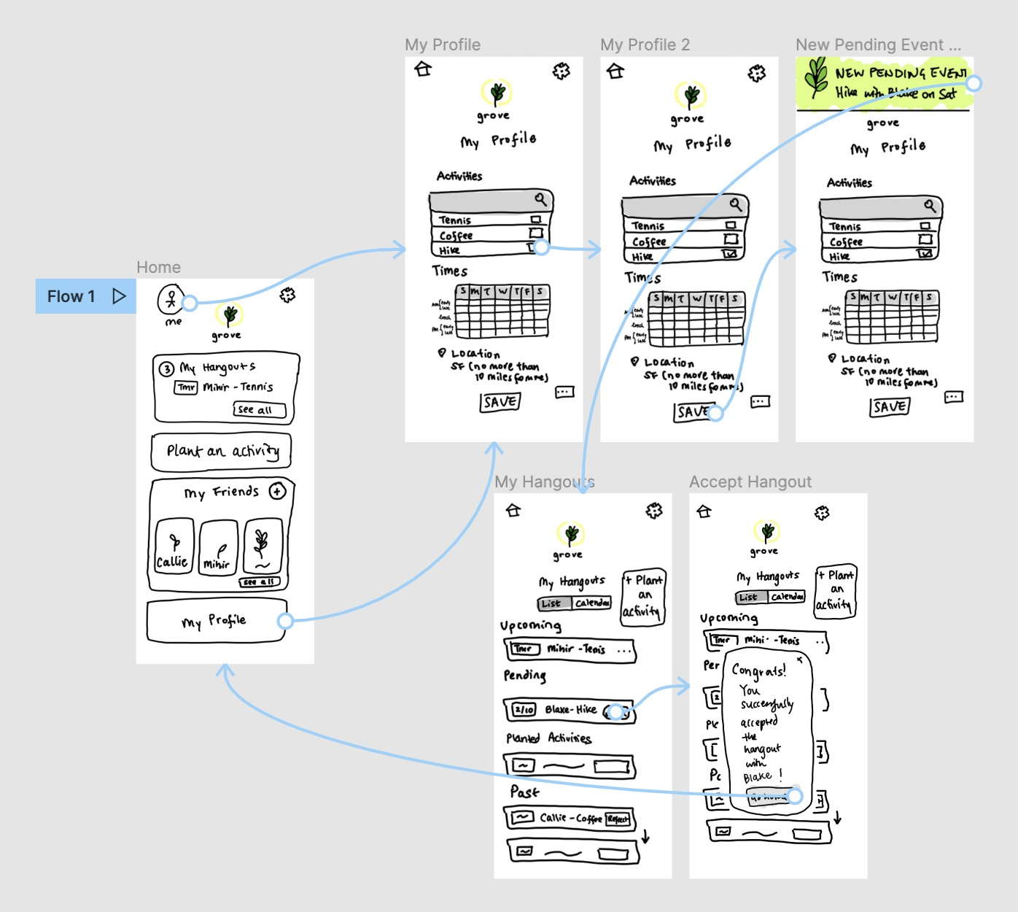
Simple Task - Accept a hangout

Slide 21
Medium Task
Plan an intentional cadence of future communication and hangouts with individuals in your grove

Slide 22
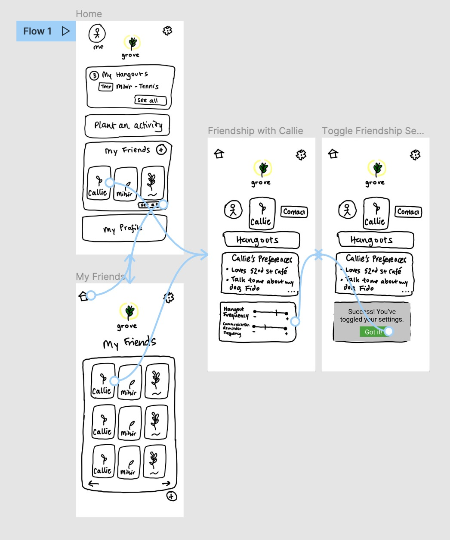
Medium Task - Plan communication

Slide 23
Medium
Task
Plant an activity–post an activity that you want to do

Slide 24
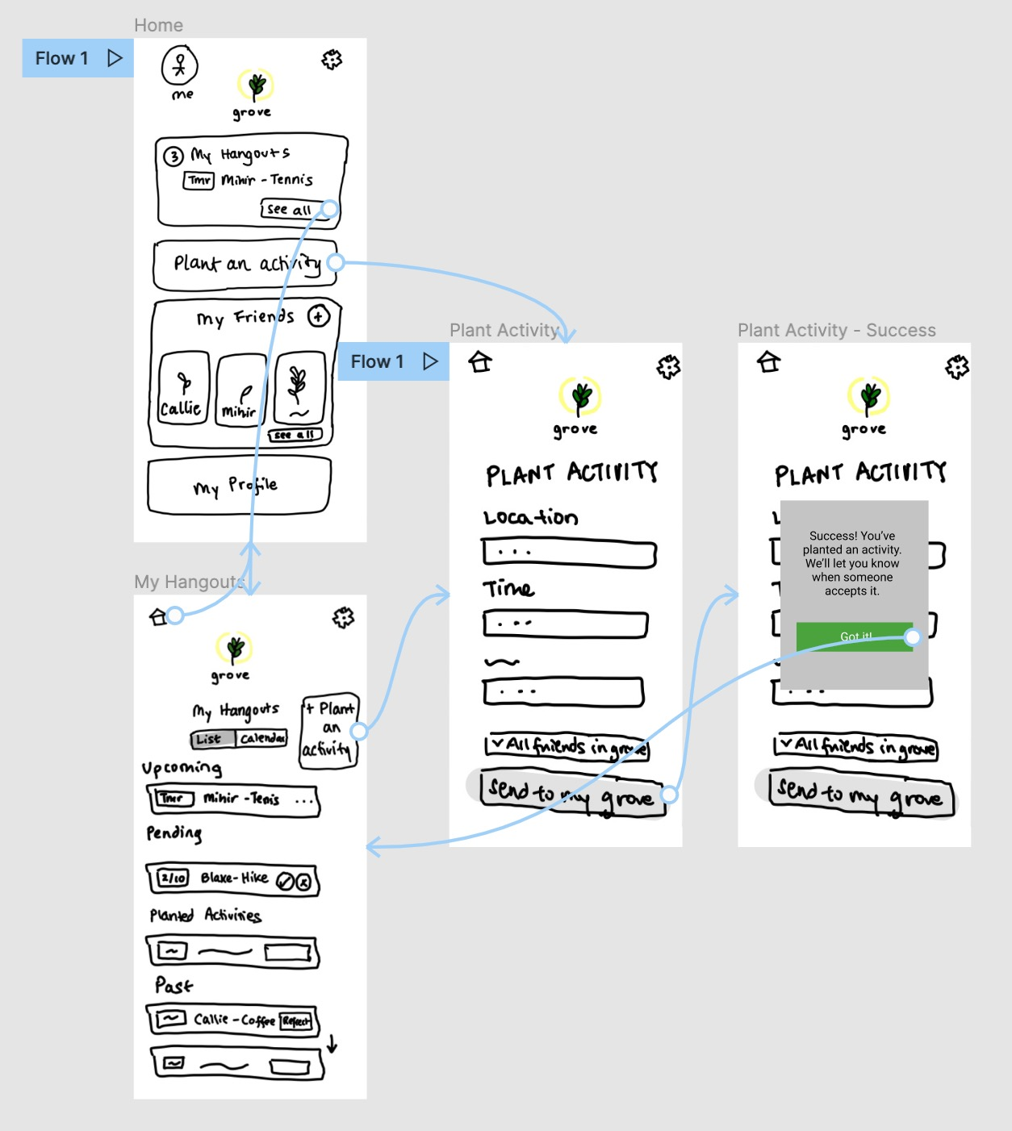
Medium Task - Plant an activity

Slide 25
Complex Task
Reflect and report on the successfulness of a hangout across various aspects - activity, location, person

Slide 26
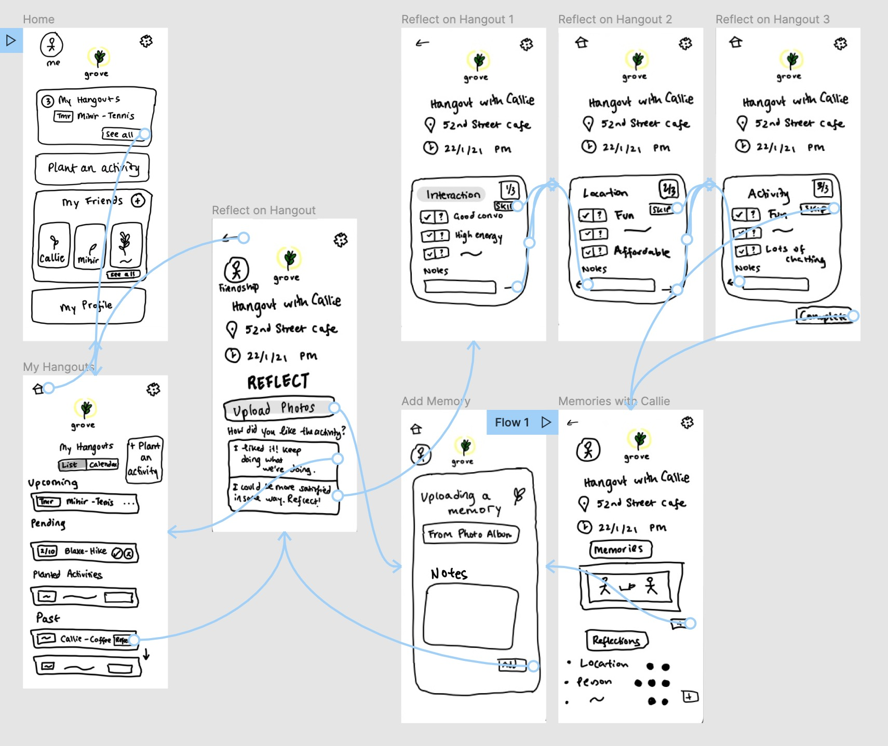
Complex Task - Post-hangout reflection

Slide 27
3. Usability Testing

Slide 28
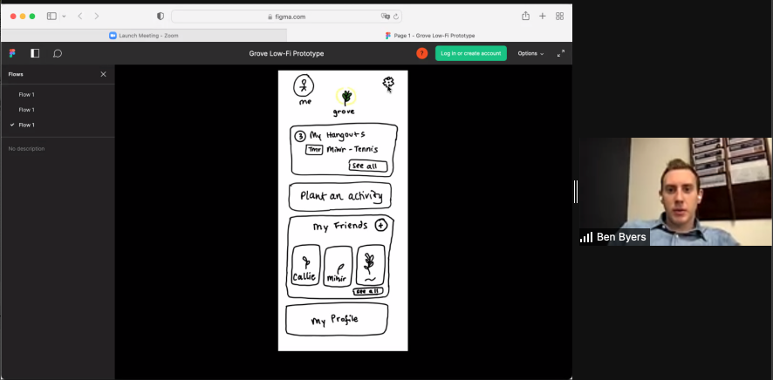
Experimental Method
Zoom with screen-share
Used Figma with click-through
No compensation

Slide 29
Participants
01
02
Julia
Mei
03
04
Gabe
Ben
Stanford coterminal master's’ student, searching for jobs outside of CS in academia
USC Senior from Kansas, first-gen American, interested in design
University of Utah upperclassman studying CS
BYU Senior, moving to NY after graduating working in consulting
Selected for diversity of college and post-college pathway experiences

Slide 30
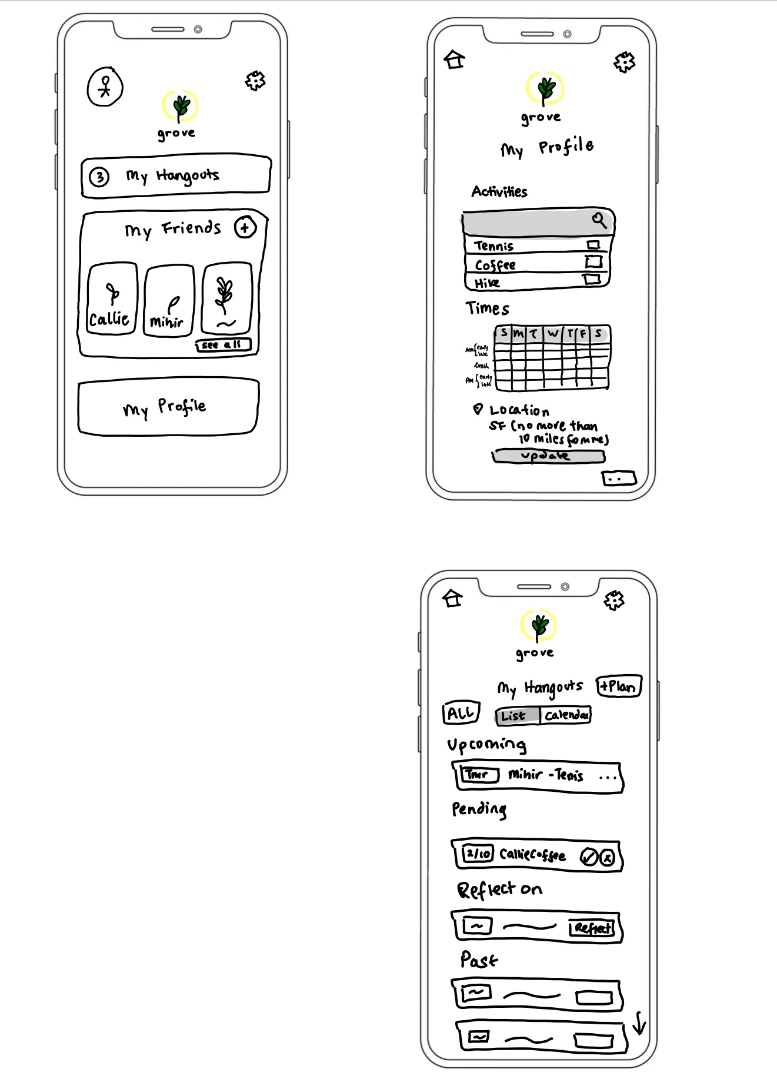
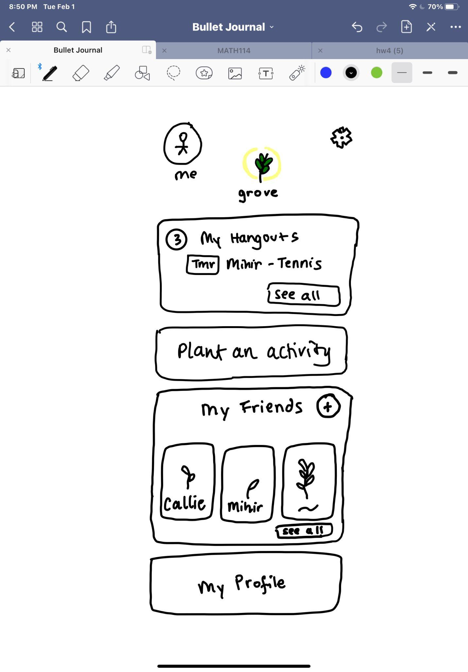
Methods
Moderate. Post a hangout in the app so that Grove can a find a person to do it with you.
Moderate. Can you update your settings for how often you want to hangout with Callie?
Simple. Can you set your activity preference (say you like hiking) and then accept an activity that aligns with those preferences?
Complex. You just completed a hangout with Callie! Reflect and report on the successfulness of that hangout.

Slide 31
4. Results / Analysis

Slide 32
Usability Goals &
Measurements
Task completion
Speed
Verbal / Physical Signs
Unexpected Actions
All participants were able to complete all tasks with little to limited redirection
All users were able to complete each task in under the specified maximum amount of time
Limited expressions of frustration except for in completing our complex reflection task
Incorrect or unexpected clicking on parts of the screen that didn't relate to task or in task order

Slide 33
Results - Concept Understanding
“This is so cute! So, my grove is kind of like a plant nursery of friends.”
Notes:
Concept was clear to all participants–plant metaphor representing friends, stage of growth of plants representing strength of friendship.

Slide 34
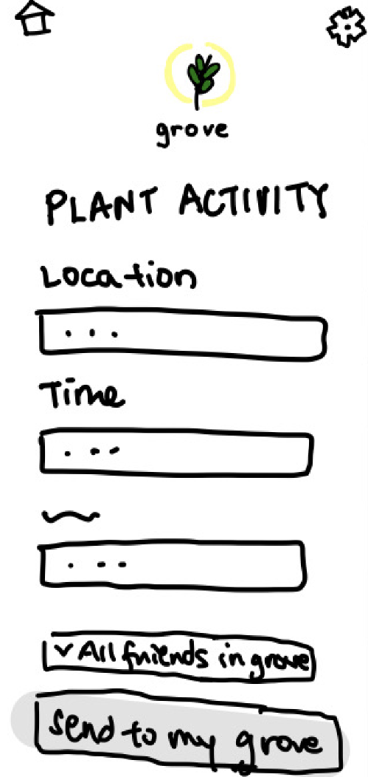
Results - Plant an activity
Concept of “planting an activity” (posting an activity) that you want to do on the app so Grove pairs you with someone to do it with was intuitive

Slide 35
Results - Homescreen
Wasn’t sure where to “update activity settings”–’My Profile’ vs. ‘Settings’ Vs. ‘Plant an activity’
To update settings with a Callie, tried going through personal ‘Settings’ instead of ‘Callie’

Slide 36
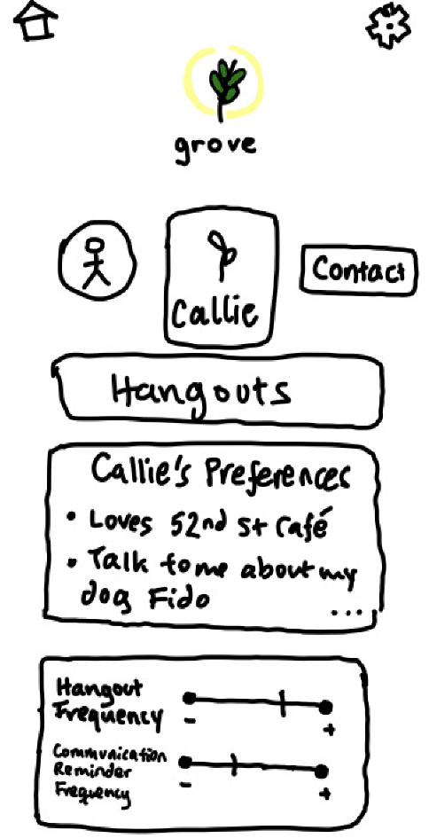
Results - Friend screen
What is “frequency of communication”? Wasn’t sure what that had to do with deepening a friendship

Slide 37
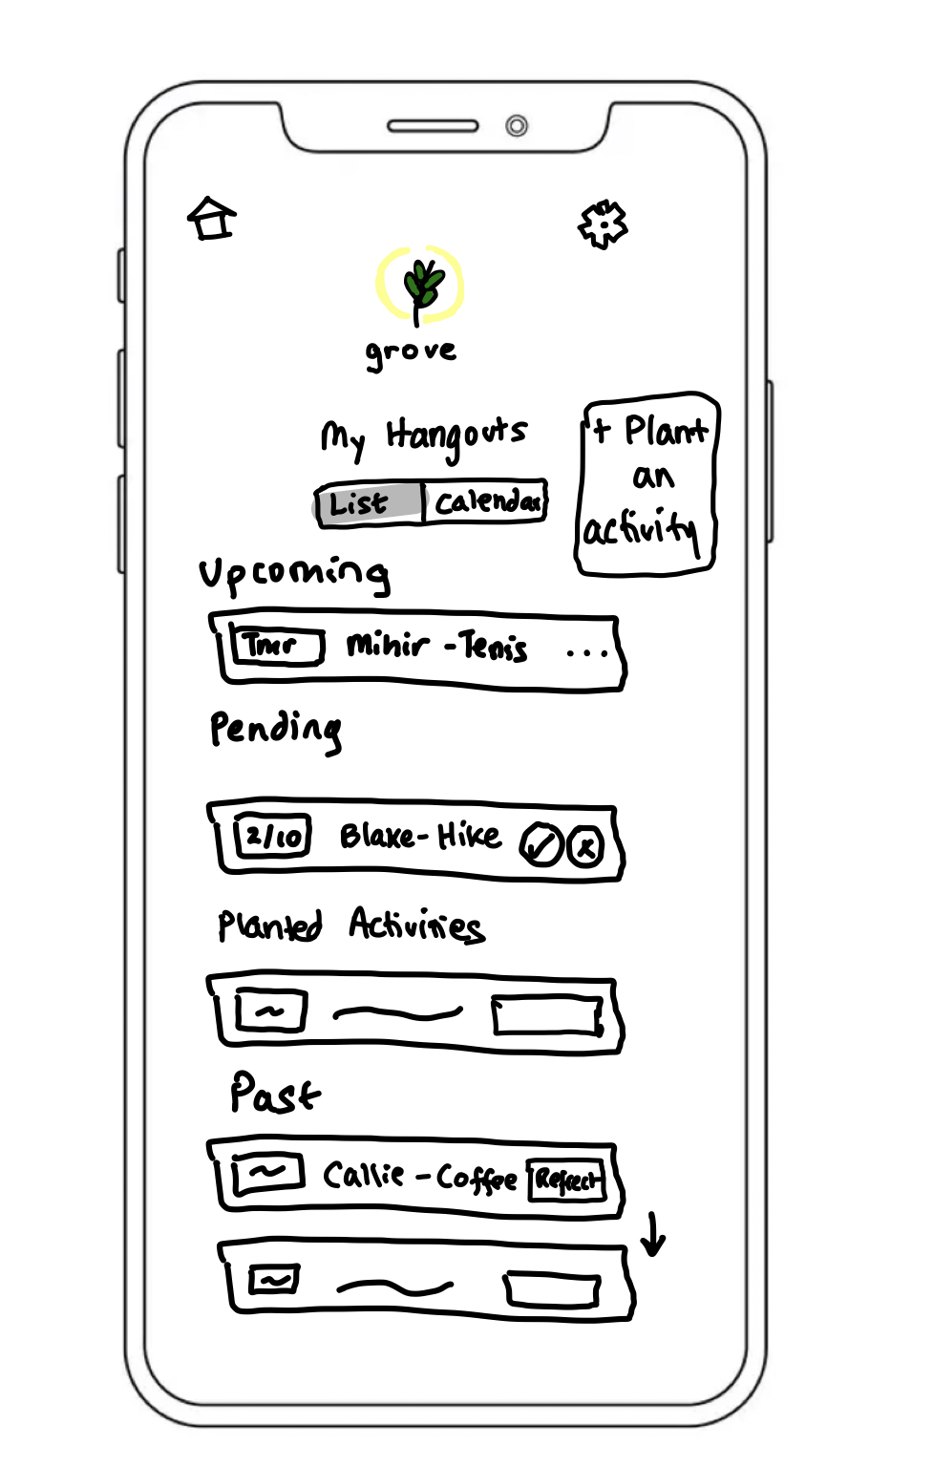
Results - Hangouts screen
Hard to see when to-do items appear like accepting hangout.
"Does that say "report"? Oh it's meant to be "reflect". That's a bit hard to find."

Slide 38
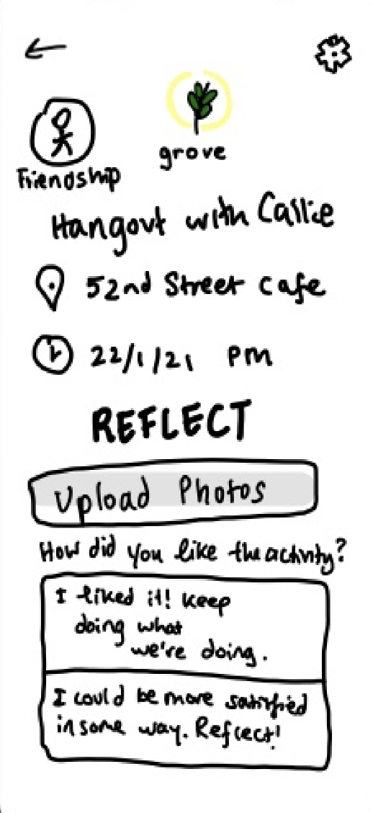
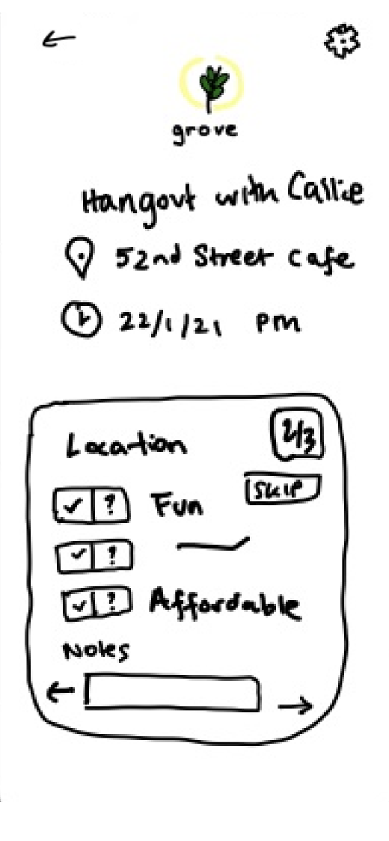
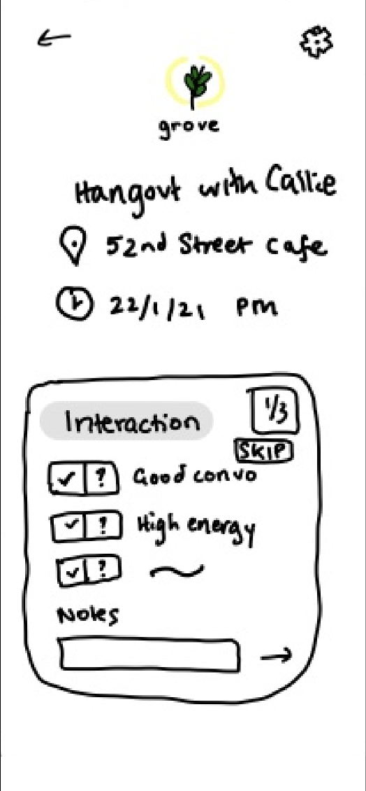
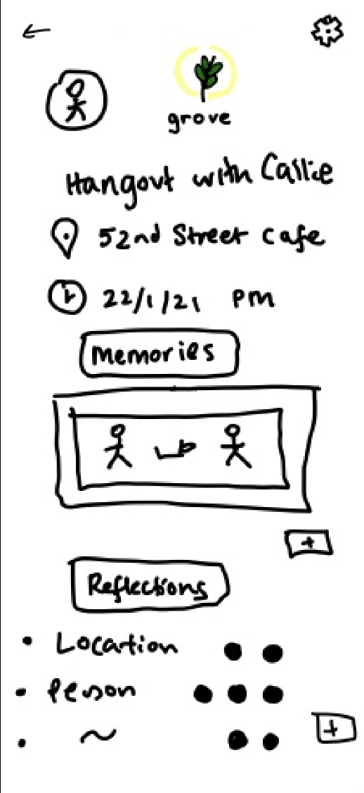
Results - Hangout reflection (1/3)
Confusion of how to go back and forth between various screens
Unsure why there were so many things to reflect on if you didn’t like the hangout

Slide 39
Results - Hangout reflection (2/3)
“Is this reflection anonymous? I don’t want my friend to see this.”
Notes:
A few users were unclear about the purpose of reflection and worried that their friends would see the way they rated a hangout.

Slide 40
Results - Hangout reflection (3/3)
“I worry that pushing users to over-analyze their friendship might actually put too much pressure on it. It could even be a little harmful.”

Slide 41
Explicit Wants and Suggestions
Don't give an option to judge a friend
Use bright colors and even more white space
Use binarized reflection for improving future hangouts only
Allow mutual friends to join 'planted activities'

Slide 42
Key Surprising Learnings
Reflections should be very low stakes to deepen friendship
Hard to distinguish static and active settings
Anonymity needs to be clearly visible
Action items need to be extremely obvious

Slide 43
Potential UI Changes
Rethink “Reflection” Functionality
Improve Clarity
Remove evaluation of friend
Refactor division of settings
Replace binary reflection with spectrum for other categories
Enlarge buttons for important tasks like accepting pending hangout or reflecting on hangout
State privacy status explicitly
Improve description of "frequency of communication"

Slide 44
Next Steps
1
2
3
Re-design some key features such as “Reflect” functionality
Update our low-fi designs based on UI feedback
Build a medium-fi prototype with visual design choices

